Slide 1


Parallelization of Karger’s Algorithm using OpenMP, MPI and CUDA
Gayathri C, Manimegalai R, Noor Mahammad SK
Paper ID - 106
Presented by
Gayathri C
International Conference on Communication Systems (ICOCS-2023)

Slide 2
Introduction
Related Work
Proposed Methodology
Results and Discussion
Conclusions
Introduction
Graphs are used to visualize and study relationships and organizational systems e.g. a social network graph where vertex => person and edges=>friendship
Graph algorithms are effective tools for extracting knowledge from graphs
Graph algorithms can become computationally costly when it is used to represent real world application
Parallelization decreases execution time, and increases speedup
Parallelization is done using OpenMP, MPI and CUDA
International Conference on Communication Systems (ICOCS-2023)
Notes:
2

Slide 3
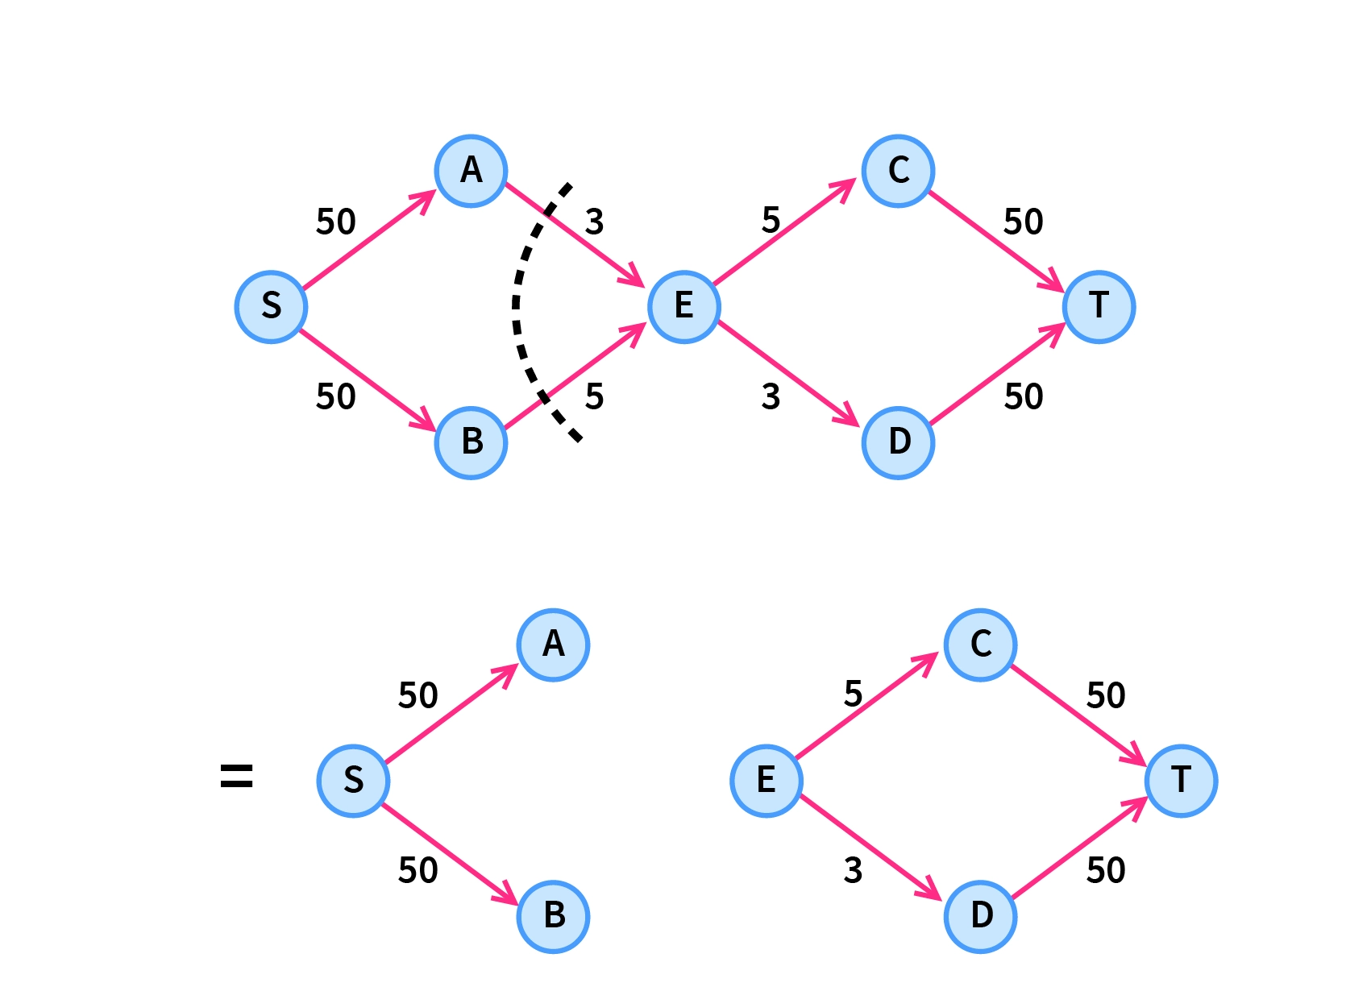
Introduction
Related Work
Proposed Methodology
Results and Discussion
Conclusions
Introduction
Karger's method determines the minimum cut in an unweighted, undirected graph
The minimum no.of edges required to remove to disconnect the graph into two components is called minimum cut.
International Conference on Communication Systems (ICOCS-2023)
Notes:
3

Slide 4
Introduction
Related Work
Proposed Methodology
Results and Discussion
Conclusions
Related Work
S.No | Title | Findings
1. | Pise, Chetan D. and Shailendra W. Shende. “Parallelization of BFS Graph Algorithm using CUDA.” In International Journal of Computing and Technology, Volume 1, Issue 3, pp:38-43, 2014. | Breadth-First Search (BFS) is a fundamental primitive for graph traversal. Demonstrates the application of CUDA in BFS. Speed-up factor(CPU/GPU) is 14.11x
2. | Wang, Wei, Yongzhong Huang, and Shaozhong Guo. "Design and Implementation of GPU-based Prim's Algorithm.", In International Journal of Modern Education and Computer Science 3.4, pp:55-62, 2011 | Prim's algorithm is a minimum spanning tree algorithm Prim’s algorithm is implemented in CUDA. Obtains a limited speedup of 2.
International Conference on Communication Systems (ICOCS-2023)
Notes:
4

Slide 5
Introduction
Related Work
Proposed Methodology
Results and Discussion
Conclusions
Related Work
S.No | Title | Findings
3. | Fagginger Auer, B.O., Bisseling, R.H. "A GPU Algorithm for Greedy Graph Matching". In Edited Book: Keller, R., Kramer, D., Weiss, JP. (eds) Facing the Multicore - Challenge II. Lecture Notes in Computer Science, vol 7174. Springer, pp:108-119, 2012. | A fine-grained shared-memory parallel algorithm for maximal greedy matching is introduced, together with an implementation on the GPU Shows speedups upto a factor of 6.8 pertaining to random matching and 5.6 pertaining to weighted matching
4. | Wassenberg, Jan, Wolfgang Middelmann, and Peter Sanders. "An Efficient Parallel Algorithm for Graph-based Image Segmentation." In IEEE International Conference on Computer Analysis of Images and Patterns, Springer, pp:1003–1010, 2009. | Minimum Spanning Tree-based algorithm for image segmentation A fast parallel implementation for shared-memory machines The parallel speedup varies between 2 and 3.2
International Conference on Communication Systems (ICOCS-2023)
Notes:
5

Slide 6
Introduction
Related Work
Proposed Methodology
Results and Discussion
Conclusions
Related Work
S.No | Title | Findings
5. | Ameen, A. T., Fouad, A. M., Matta, E. M., Elkhishen, R. A., Alalem, S. A., Safan, A. M., & Halim, I. T. A. "Comparison of Parallel and Serial Execution of Shortest Path Algorithms" In IEEE International Conference on Computational Intelligence and Knowledge Economy pp: 232-237, 2023. | Dijkstra, Bellman-Ford, and Floyd Warshall - are both implemented as serial and parallel programs To achieve parallelization, the OpenMP framework is employed. Parallel implementation outperforms serial implementation in all three algorithms.
International Conference on Communication Systems (ICOCS-2023)
Notes:
6

Slide 7
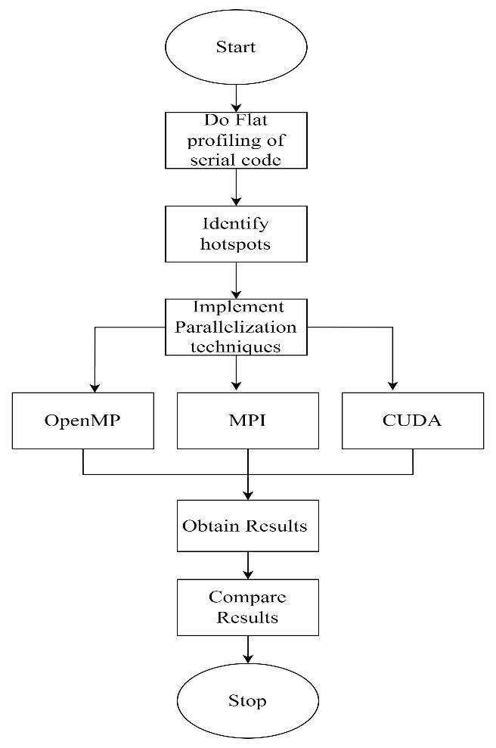
Introduction
Related Work
Proposed Methodology
Results and Discussion
Conclusions
Proposed Methodology
1)Profiling
Profiling is a technique that is used to identify the hotspots
Profiling is employed to have an in-depth understanding of the algorithm and to find opportunities for parallelizing the algorithm
While various tools are available for profiling, in this work gprof of the GNU Compiler Collection (GCC) is used
International Conference on Communication Systems (ICOCS-2023)
Notes:
7

Slide 8
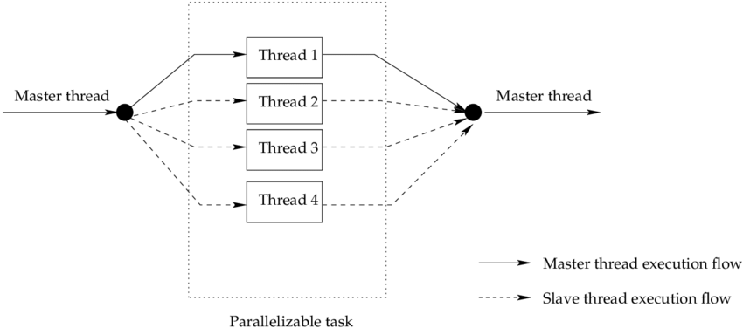
Introduction
Related Work
Proposed Methodology
Results and Discussion
Conclusions
Proposed Methodology
2)OpenMP(Open Multi-Processing) implementation
Each iteration of the loop is run concurrently through multiple threads in parallel
All threads share same memory space
Synchronization of various threads is taken care of by OpenMP
International Conference on Communication Systems (ICOCS-2023)
Notes:
8

Slide 9
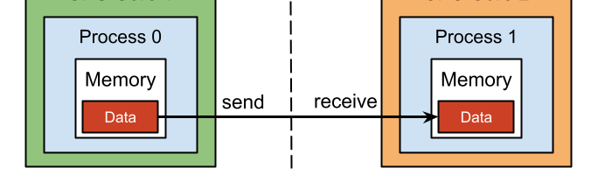
Introduction
Related Work
Proposed Methodology
Results and Discussion
Conclusions
Proposed Methodology
3)MPI(Message Passing Interface) implementation
The identified hotspot code regions are distributed among various processes
Each process has its memory to enable parallelism
Data is explicitly shared by passing messages between processes
International Conference on Communication Systems (ICOCS-2023)
Notes:
9

Slide 10
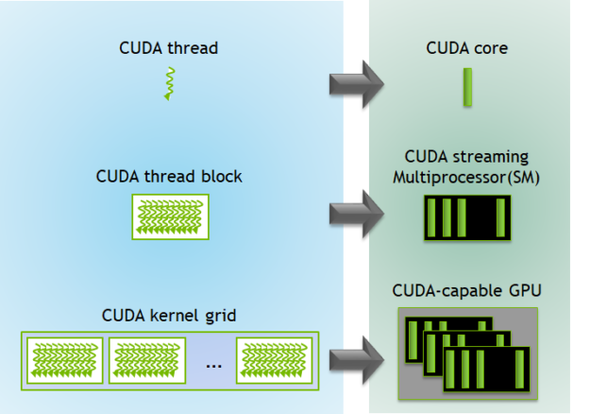
Introduction
Related Work
Proposed Methodology
Results and Discussion
Conclusions
Proposed Methodology
4)CUDA(Compute Unified Device Architecture) implementation
CUDA allows developers to harness the computational power of GPUs for parallel processing tasks
In CUDA terminology, the CPU is referred to as the host, and the GPU is referred to as the device
The host manages the overall computation, while the device (GPU) performs parallel processing tasks
Here, a kernel is defined in which each thread is responsible for checking a single edge
International Conference on Communication Systems (ICOCS-2023)
Notes:
10

Slide 11
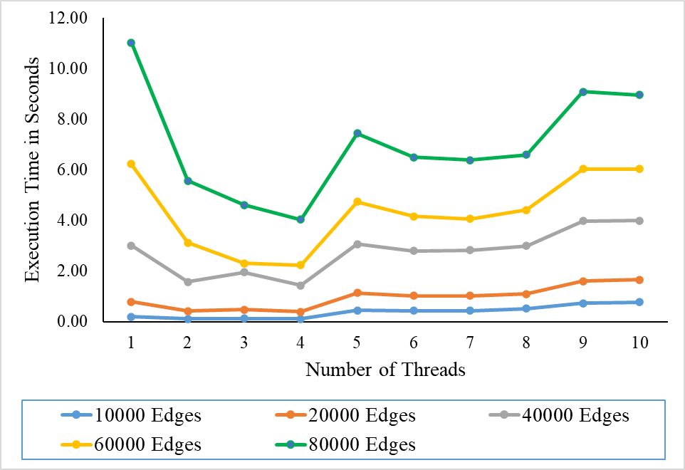
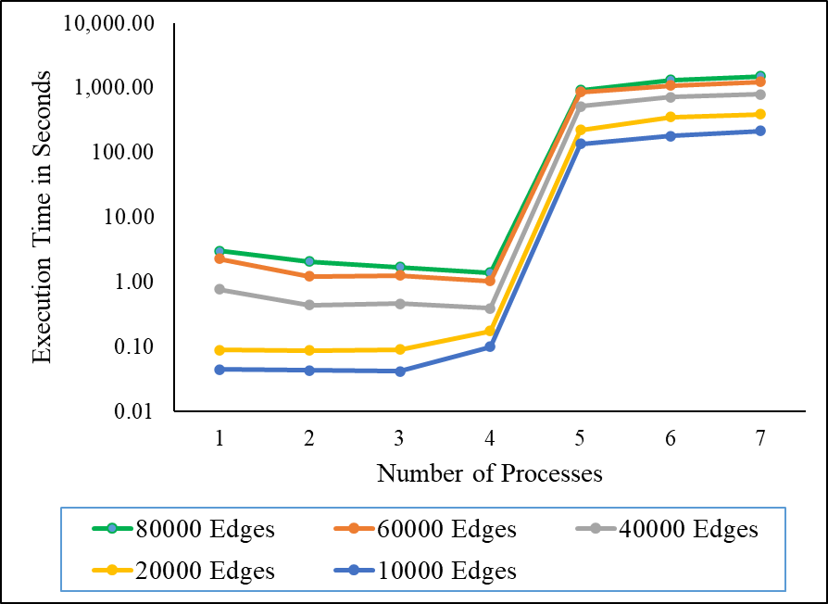
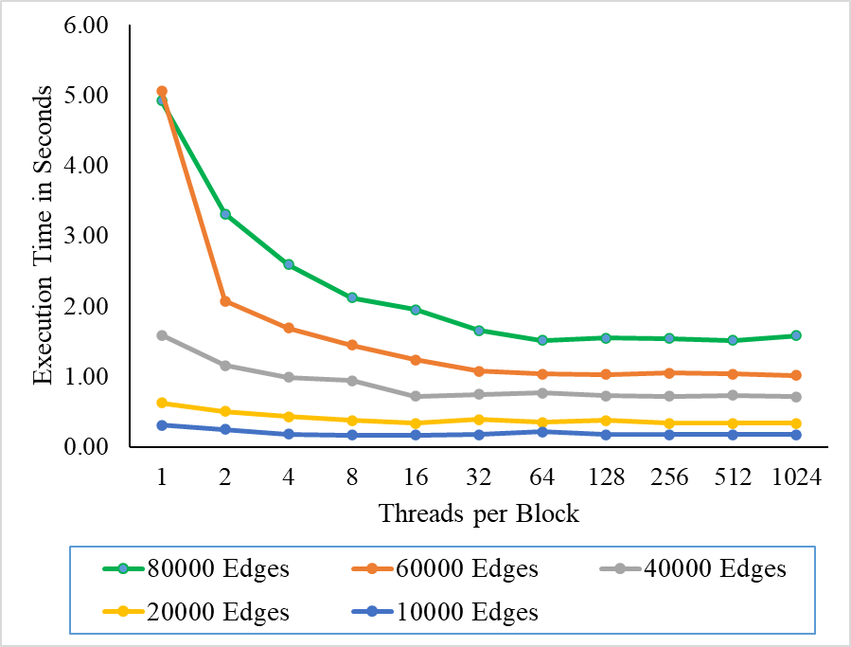
Introduction
Related Work
Proposed Methodology
Results and Discussion
Conclusions
Results and Discussions
OpenMP
MPI
CUDA
International Conference on Communication Systems (ICOCS-2023)
Notes:
11

Slide 12
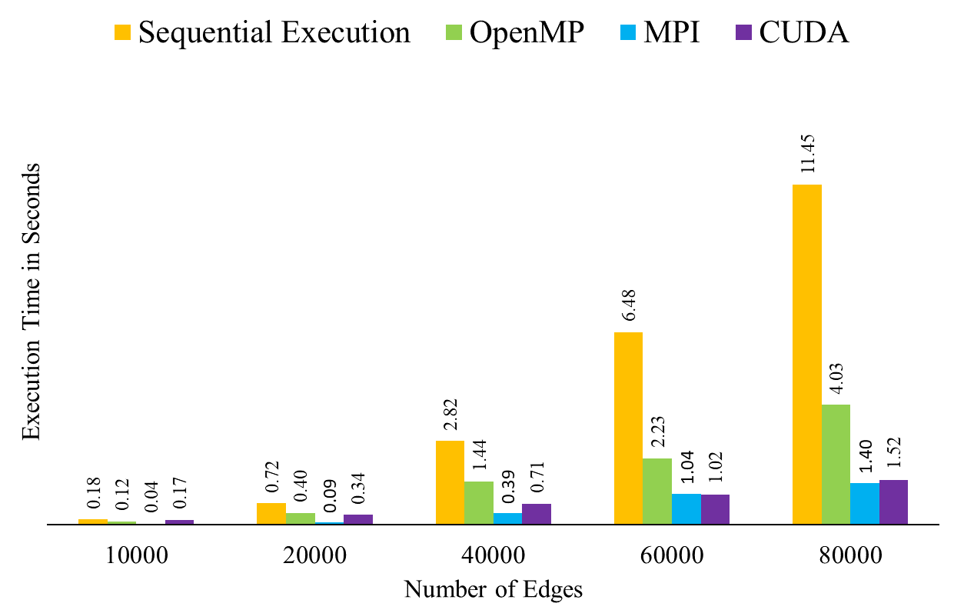
Introduction
Related Work
Proposed Methodology
Results and Discussion
Conclusions
Conclusions
The parallel implementation of Karger’s algorithm runs faster than the traditional sequential implementation
CUDA and OpenMP show better results than sequential implementation.
MPI proves to be the best among the three parallel implementations
International Conference on Communication Systems (ICOCS-2023)
IEEE - International Conference on Vision Towards Emerging Trends in Communication and Networking (ViTECoN’23)
Notes:
12

Slide 13
Introduction
Related Work
Proposed Methodology
Results and Discussion
Conclusions
References
Pise, Chetan D. and Shailendra W. Shende. “Parallelization of BFS Graph Algorithm using CUDA.” In International Journal of Computing and Technology, Volume 1, Issue 3, pp:38-43, 2014.
Wang, Wei, Yongzhong Huang, and Shaozhong Guo. "Design and Implementation of GPU-based Prim's Algorithm.", In International Journal of Modern Education and Computer Science 3.4, pp:55-62, 2011.
Fagginger Auer, B.O., Bisseling, R.H. "A GPU Algorithm for Greedy Graph Matching". In Edited Book: Keller, R., Kramer, D., Weiss, JP. (eds) Facing the Multicore - Challenge II. Lecture Notes in Computer Science, vol 7174. Springer, pp:108-119, 2012.
International Conference on Communication Systems (ICOCS-2023)
Notes:
13

Slide 14
Introduction
Related Work
Proposed Methodology
Results and Discussion
Conclusions
References
Wassenberg, Jan, Wolfgang Middelmann, and Peter Sanders. "An Efficient Parallel Algorithm for Graph-based Image Segmentation." In IEEE International Conference on Computer Analysis of Images and Patterns, Springer, pp:1003–1010, 2009.
Ameen, A. T., Fouad, A. M., Matta, E. M., Elkhishen, R. A., Alalem, S. A., Safan, A. M., & Halim, I. T. A. "Comparison of Parallel and Serial Execution of Shortest Path Algorithms" In IEEE International Conference on Computational Intelligence and Knowledge Economy pp: 232-237, 2023.
International Conference on Communication Systems (ICOCS-2023)
Notes:
14

Slide 15
Any Questions
International Conference on Communication Systems (ICOCS-2023)

Slide 16
Thank You
International Conference on Communication Systems (ICOCS-2023)
Notes:
16

